Slide 1
Testing of Tuition Management System Web App
Software Testing
Sadman Sakib Sefat 2019-2-60-032
Md. Abu Rayhan
2019-2-60-061

Slide 2

Description:
In this software testing presentation, we will walk you through the comprehensive testing process of our Tuition Management System web application. Our testing approach is divided into two key parts: Static Analysis and Dynamic Testing.
Static Analysis:
Sequence Diagrams: We will showcase three essential sequence diagrams representing critical functionalities of the project.
LTS Analysis: We will present LTS (Labelled Transition System) coding and transition diagrams of each sequence diagram using a specialized tool. This analysis provides insights into the logical flow and potential issues within the application's architecture.
Dynamic Testing:
Test Cases: We will identify and execute 3-4 crucial test cases meticulously designed to evaluate the system's functionality, performance, and robustness.
Live Execution: You will witness the live execution of these test cases, validating the reliability and stability of our Tuition Management System.

Slide 3
Static Analysis
Sequence Diagram

Slide 4
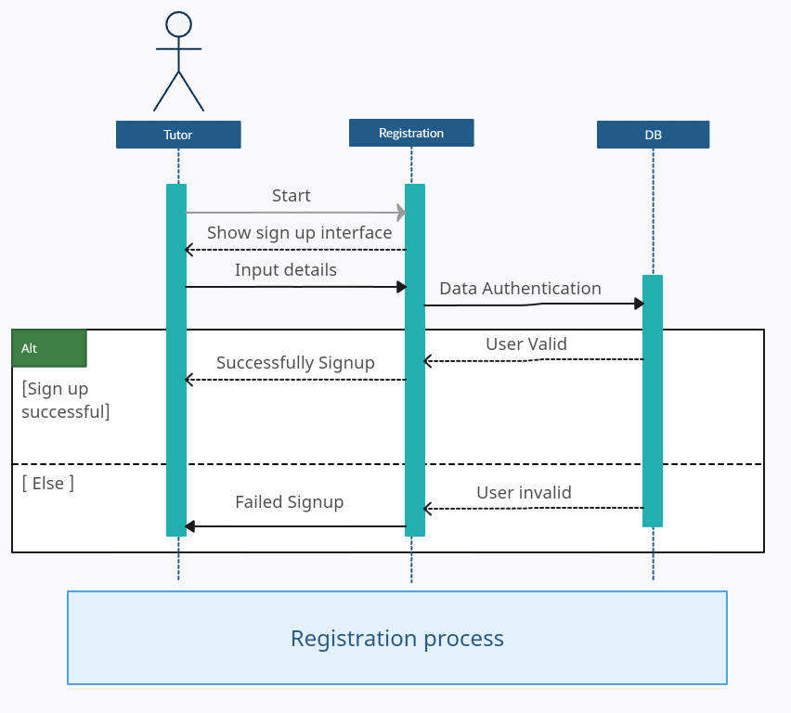

Slide 5
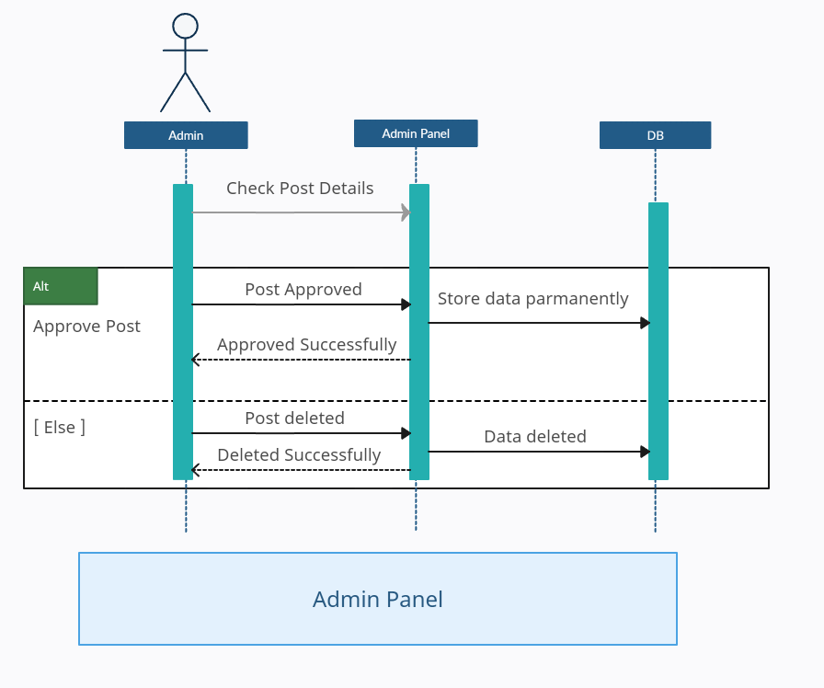

Slide 6
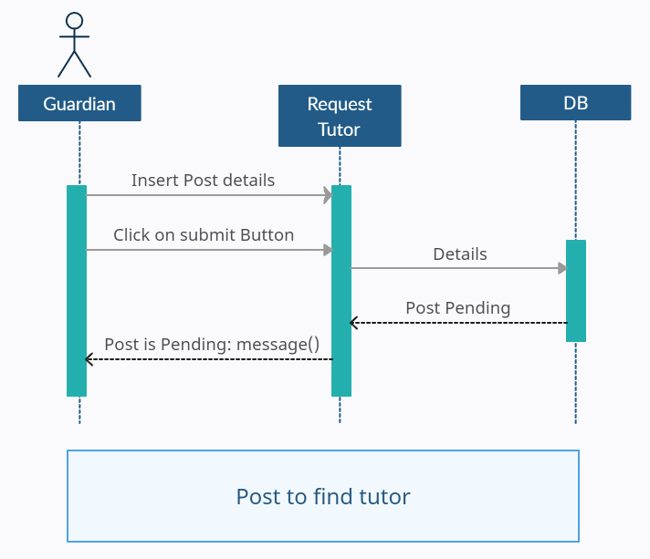

Slide 7
Static Analysis
LTS Coding & Transition Diagram

Slide 8
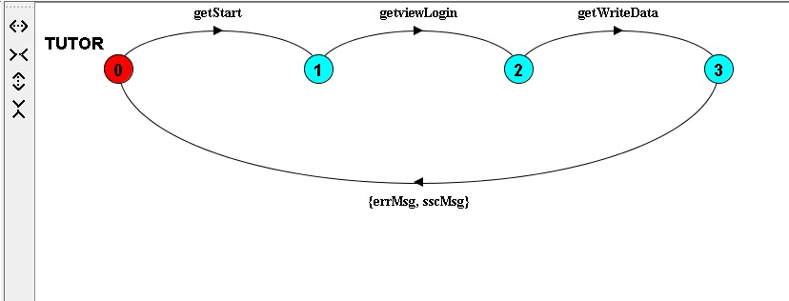
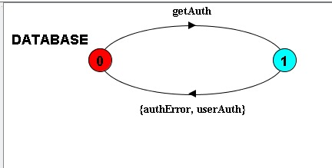
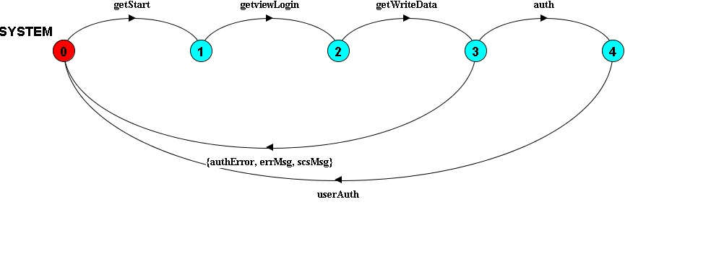
LTS Analysis for Registration Sequence
1. TUTOR = (start->getviewLogin->writeData->(getErrMsg->
TUTOR|getScsMsg->TUTOR)).
3. DATABASE = (getAuth->(userAuth->DATABASE|authError->DATABASE)).
2. SYSTEM = (getStart->viewLogin->getWriteData->(errMsg->
SYSTEM|scsMsg->SYSTEM|auth->getUserAuth->
SYSTEM|getAuthError->SYSTEM)).

Slide 9
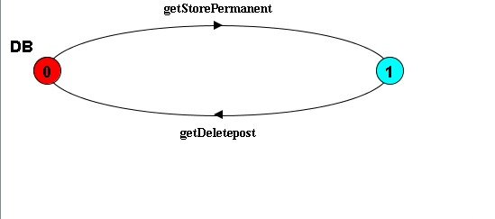
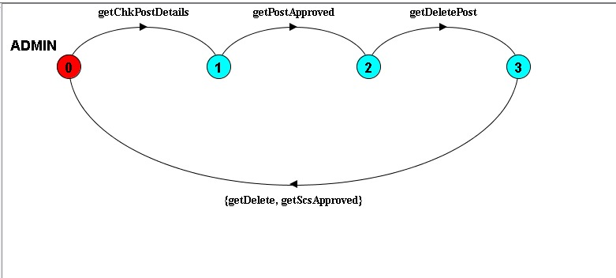
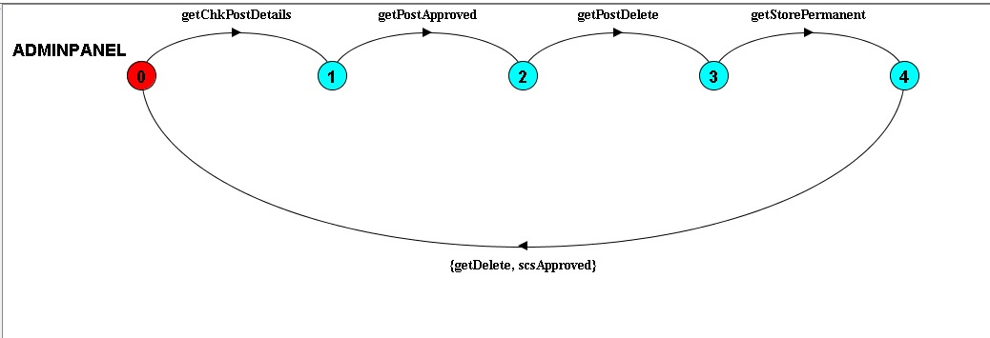
LTS Analysis for Admin Sequence
3. DB = (getStorePermanent->getDeletepost->DB).
1. ADMIN = (chkPostDetails->postApproved->deletePost->(getScsApproved->ADMIN|delete->ADMIN)).
2. ADMINPANEL= (getChkPostDetails->getPostApproved->getPostDelete->storePermanent->(scsApproved->ADMINPANEL|getDelete->ADMINPANEL)).

Slide 10
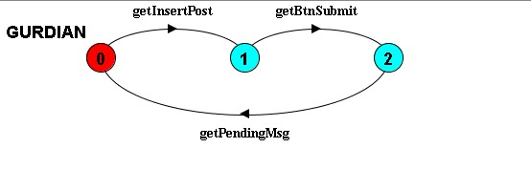
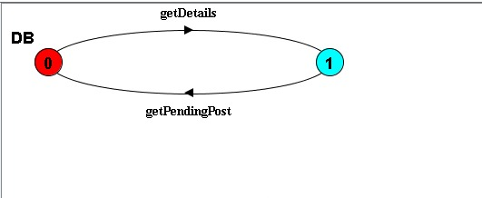
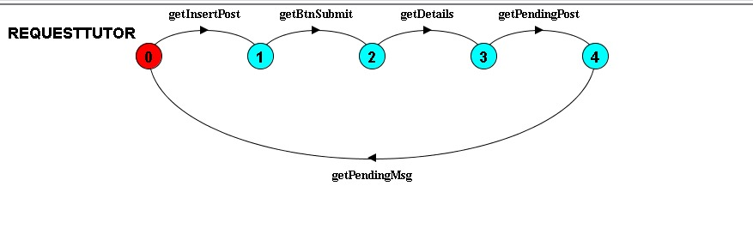
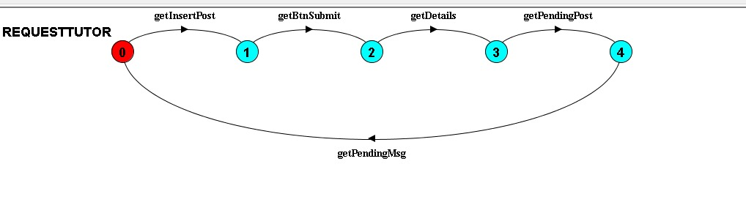
LTS Analysis for Request Tutor Sequence
1..GURDIAN = (insertPost->btnSubmit->getPendingMsg->GURDIAN).
3. DB = (getDetails->pendingPost->DB).
2. REQUESTTUTOR = (getInsertPost->getBtnSubmit->details->getPendingPost->pendingMsg->REQUESTTUTOR).
4. ||REQUESTTUTOR =(GURDIAN || REQUESTTUTOR || DB) / {getInsertPost/insertPost, getPendingMsg/pendingMsg, getBtnSubmit/btnSubmit, getDetails/details, getPendingPost/pendingPost, getPendingMsg/pendingMsg}.

Slide 11
Dynamic Testing
Test cases & Execution of test cases

Slide 12
Test Case Tools
Selenium
VS Studio Code
Python
Chrome

Slide 13
Test Cases
Registration
Login
Search

Slide 14
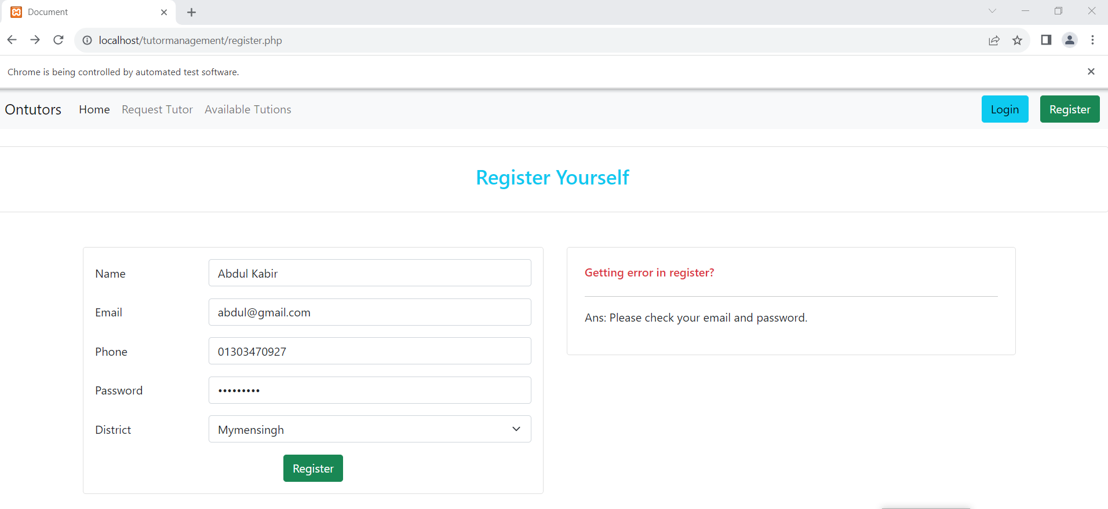
Registration Test Cases
Test Case 1
Valid data

Slide 15
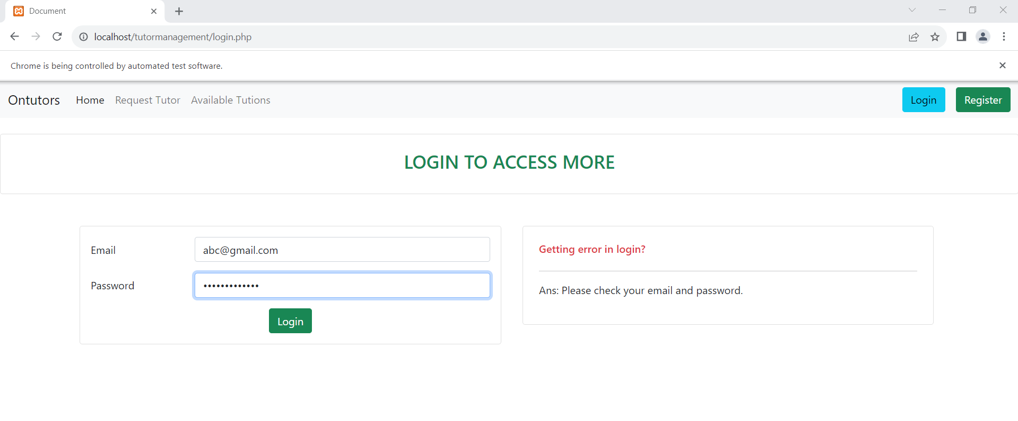
Login test Cases
Test Case 1
Invalid data
Test Case 2
Valid data

Slide 16
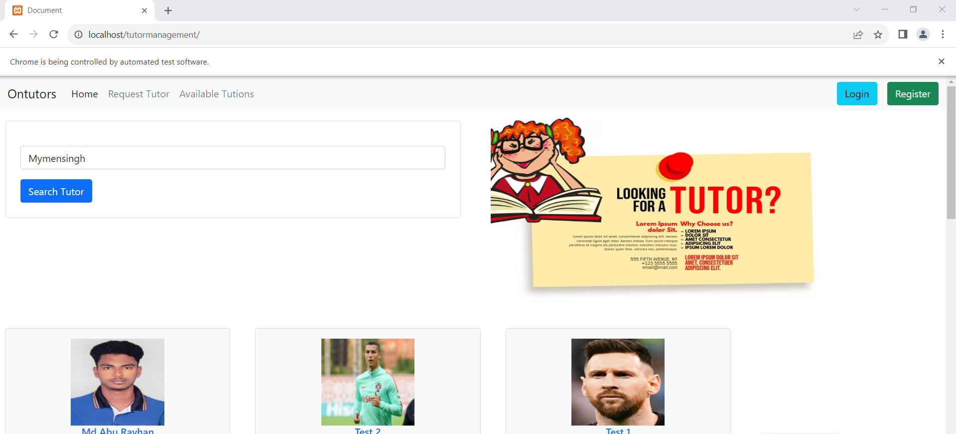
Search Test Cases
Test Case 1
Valid data
District wise search

Slide 17
Thank You

